Slide 1
Advanced Software Engineering
Module III

Slide 2
Syllabus
OOP Concepts; Design Patterns: Basic concepts of Design patterns, How to select a design pattern, Creational patterns, Structural patterns, Behavioural patterns. Concept of Anti-patterns.
Unit testing and Unit Testing frameworks, The xUnit Architecture, Writing Unit Tests using at least one of Junit (for Java), unittest (for Python) or phpdbg (PHP). Writing tests with Assertions, defining and using Custom Assertions, single condition tests, testing for expected errors, Abstract test.

Slide 3
OOP Concepts
Object Oriented is a popular design approach for analyzing and designing an application.
Most of the languages like C++, Java, .net use object oriented design concept.
Object-oriented concepts are used in the design methods such as classes, objects, polymorphism, encapsulation, inheritance, dynamic binding, information hiding, interface, constructor, destructor etc.

Slide 4
Continues..
Advantages of Object Oriented Design
Improving the software development and maintainability.
Faster and low cost development.
Creates a high quality software.
Disadvantages
Larger program size.
It is not suitable for all types of program.

Slide 5
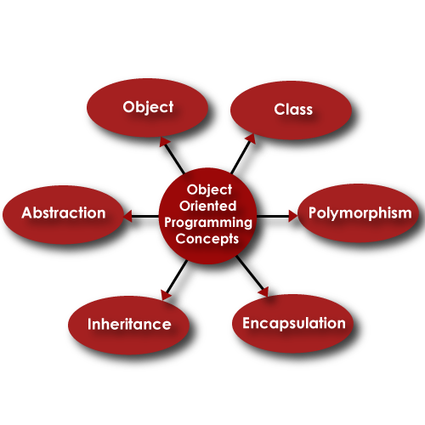
Continues..
Different terms related to Object Oriented Design are:

Slide 6
Class
A class is a collection of method and variables.
It is a blueprint that defines the data and behavior of a type.
Let’s take HumanBeing as a class.
A class is a blueprint for any functional entity which defines its properties and its functions.
Example HumanBeing, having body parts, performing various actions.

Slide 7
Inheritance
Inheritance is a feature of object-oriented programming that allows code reusability when a class includes property of another class.
Considering HumanBeing a class, which has properties like hands, legs, eyes, mouth, etc, and functions like walk, talk, eat, see, etc.
Man and Woman are also classes, but most of the properties and functions are included in HumanBeing.
Hence, they can inherit everything from class HumanBeing using the concept of Inheritance.

Slide 8
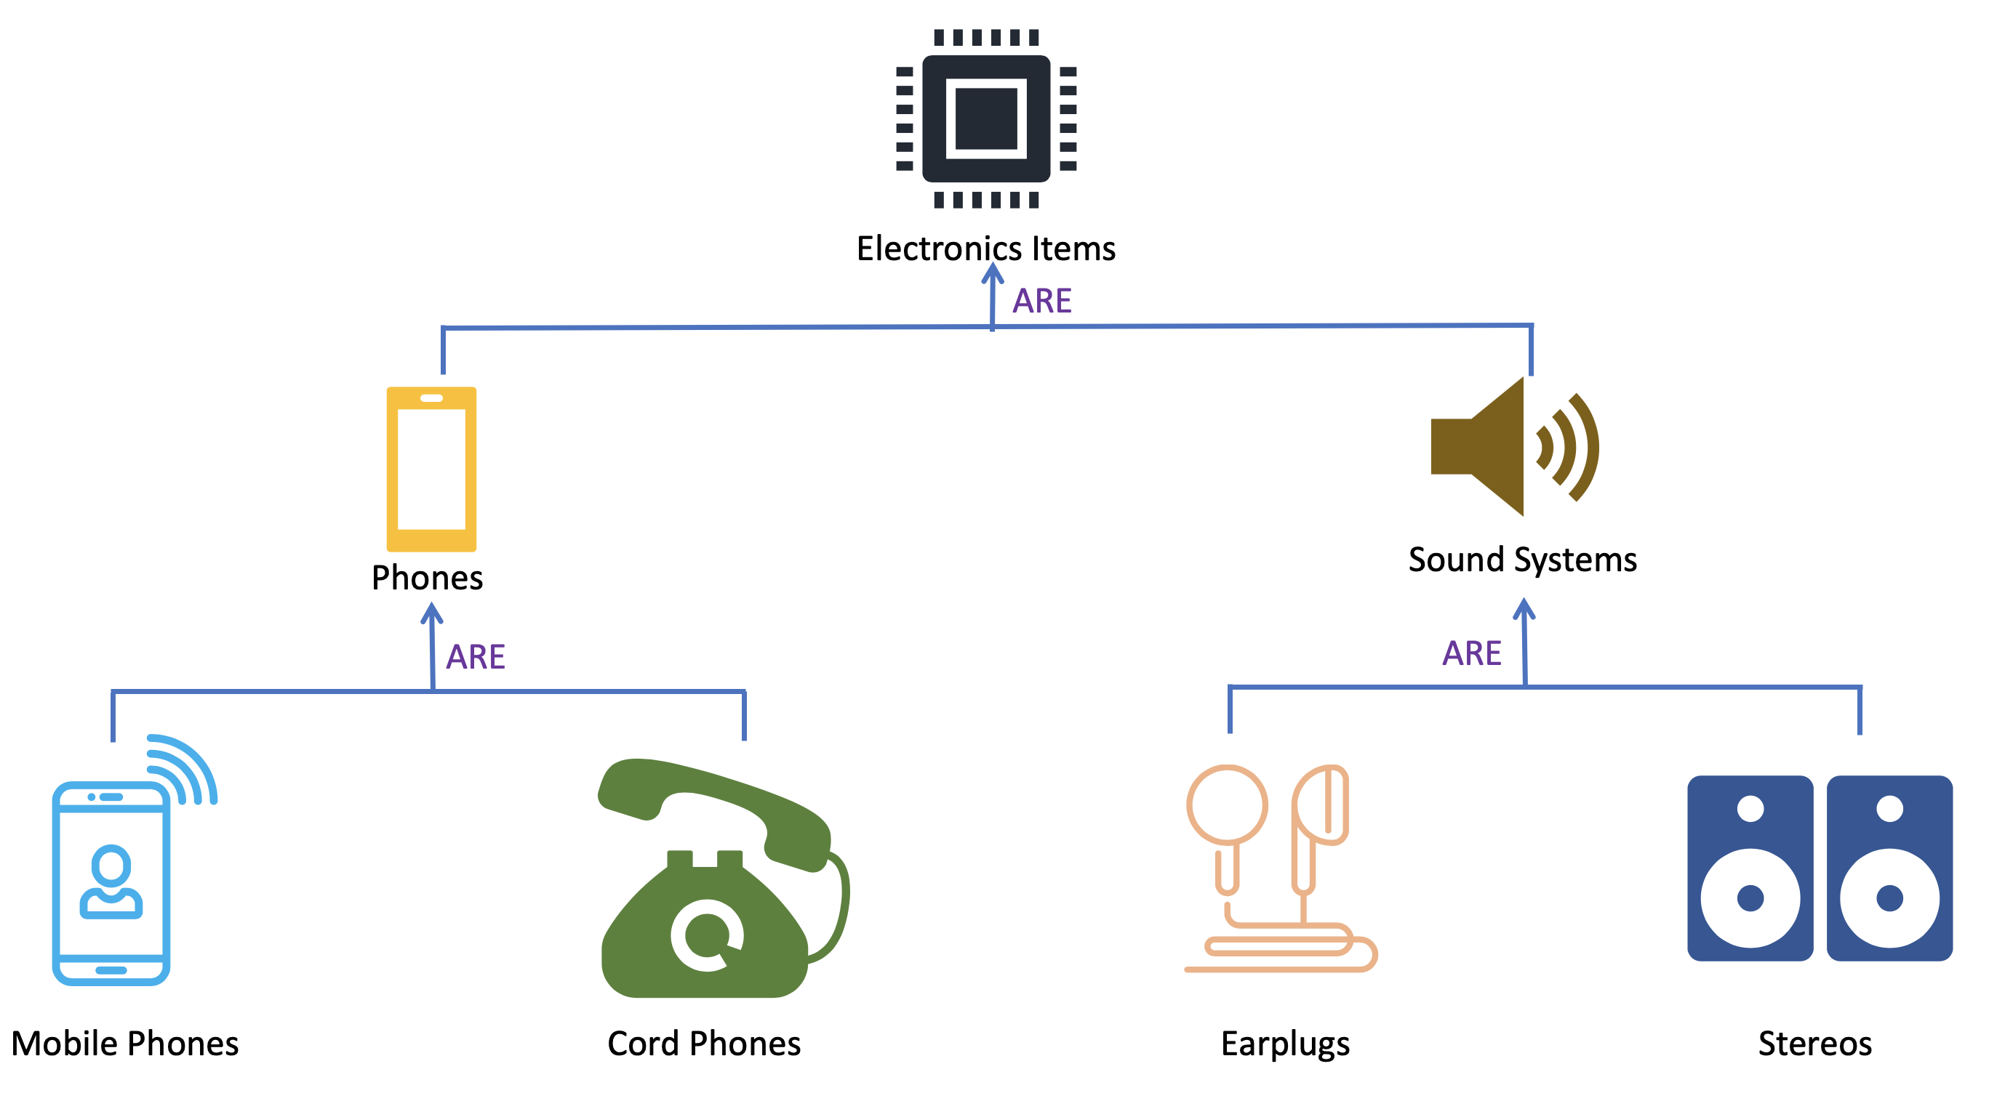
Continues..

Slide 9
Continues..
Objects :
My name is Akhil, and I am an instance/object of class Man
Abstraction :
Abstraction means, showcasing only the required things to the outside world while hiding the details.
Continuing our example, HumanBeing’s can talk, walk, hear, eat, but the details of the muscles mechanism and their connections to the brain are hidden from the outside world.

Slide 10
Continues..
Encapsulation :
Encapsulation means that we want to hide unnecessary details from the user.
For example,
when we call from our mobile phone, we select the number and press call button.
But the entire process of calling or what happens from the moment we press or touch the call button to the moment we start having a phone conversation is hidden from us.

Slide 11
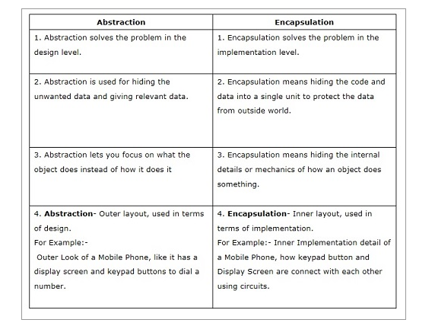
Difference between Abstraction and Encapsulation

Slide 12
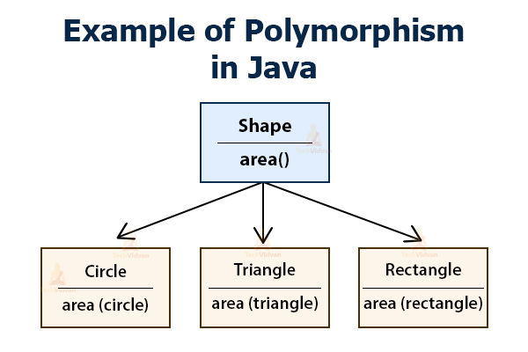
Continues..
Polymorphism :
Polymorphism is a feature of object-oriented programming languages that allows a specific routine to use variables of different types at different times.

Slide 13
Design classes
A set of design classes refined the analysis class by providing design details.
There are five different types of design classes and each type represents the layer of the design architecture these are as follows:
User interface classes :
These classes are designed for Human Computer Interaction(HCI).
Business domain classes :
These classes are required to implement the elements of the business domain.
Process classes :
Which is needed to completely manage the business domain class.
Persistence classes :
It shows data stores that will persist behind the execution of the software.
System Classes :
System classes implement software management and control functions.

Slide 14
Continues..
Design class characteristics
Complete and sufficient
Primitiveness : Fulfill one service for the class.
High cohesion : A cohesion design class has a small and focused set of responsibilities.
Low-coupling : The minimum acceptable of collaboration must be kept in the model. If a design model is highly coupled then the system is difficult to implement, to test and to maintain over time.

Slide 15
Design Patterns

Slide 16
Unit Testing
Unit testing is a software testing method by which individual units of source code, such as functions, methods, and class are tested to determine whether they are fit for use. (Verifies the correctness of a specific piece of code)
Unit tests are short code fragments created by programmers during the development process.
It forms the basis for component testing. Since unit test is the first chance to catch errors, it is extremely important.

Slide 17
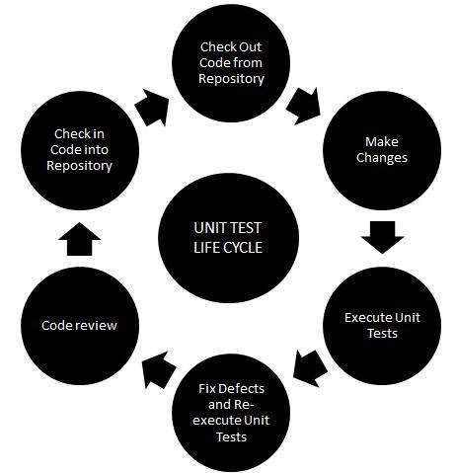
Continues..

Slide 18
Continues..
There are two types of Unit Testings
Manual Testing
Executing the test cases manually without any tool support is known as manual testing.
Automated Testing.
Taking tool support and executing the test cases by using automation tool is known as automation testing.

Slide 19
Unit Testing Frameworks
They are software tools to support writing and running unit tests, including a foundation on which to build tests and the functionality to execute the tests and report their results.
Unit test frameworks are a family of tools.
Unit test frameworks are a key element of Test Driven Development (TDD), also known as “test-first programming.”
Test frameworks achieve their maximum utility when used to enable TDD, although they still are useful when TDD is not followed.

Slide 20
Continues..
The key rule of TDD can be summarized as “test twice, code once”.
Test twice, code once” refers to the three-step procedure involved in any code change:
Step I:- Write a test, run it, and verify the resulting failure. The failure is important because it validates that the test fails as expected.
Step II:- Code is written to make the test succeed. Do “the simplest thing that could possibly work.”
Step III:- The test succeeds, verifying both the new code and its test.
At this point, the new code may be refactored. Refactoring is the process of transforming code to improve its internal design without changing its external functionality.

Slide 21
Continues..
By following the TDD cycle, you can come as close as humanly possible to writing flawless code on the first try - in other words, “code once.”
The process gives you a clear indication that a piece of work is done.
When a new unit test is written and then fails, the task is halfway completed.
You cannot move on to something else until the test succeeds.

Slide 22
History of xUnit
Kent Beck published a unit test framework for the Smalltalk language in 1999.
The architecture of SmalltalkUnit (or SUnit) represents a sweet spot, an ideal balance between simplicity and utility.
Later, Erich Gamma ported SUnit to Java, creating JUnit.
JUnit in turn begat CppUnit, NUnit, PyUnit, XMLUnit, and ports to many other languages.
A dizzying array of unit test frameworks built on the same model now exists.
These frameworks are known as the xUnit family of tools.
All are free, open source software.

Slide 23
Continues..
Some of the unit testing frameworks are:-
JUnit - JUnit is a unit testing framework for the Java programming language. The reference implementation of xUnit, JUnit is by far the most widely used and extended unit test framework. It is implemented in and used with Java.
Unittest -The Python version of xUnit. It is included as a standard component of Python 2.1
Phpdbg - phpdbg is an alternative to xdebug(It is an open source testing framework for PHP that is used for development and debugging of codes.), and is an interactive PHP debugger tool.

Slide 24
The xUnit Architecture
The xUnits all have the same basic architecture.
All xUnit frameworks share the following basic component architecture, with some varied implementation details
The key classes are TestCase, TestRunner, TestFixture, TestSuite, and TestResult.
These classes represent the core of the xUnit architecture.
To understand what they do is to understand how xUnit works.
Architecture is described using Junit since it is the most widely used of the xUnits.
The other xUnits vary in their implementation details, but follow the same pattern and generally contain the same key classes and concepts.

Slide 25
Continues..

Slide 26
Continues..
TestCase
xUnit’s most elemental class is TestCase, the base class for a unit test.
The abstract class TestCase, the parent of all xUnit unit tests.
All unit tests are inherited from TestCase.
To create a unit test, define a test class that is descended from TestCase and add a test method to it.

Slide 27
Continues..
Explanation
The test method testConstructBook( ) uses assertTrue( ) to check the value of the Book’s title. Test conditions always are evaluated by the framework’s assert methods.
If a condition evaluates to TRUE, the framework increments the successful testcounter.
If it is FALSE, a test failure has occurred and the framework records the details, including the failure’s location in the code.
After a failure, the framework skips the rest of the code in the test method, since the test result is already known.

Slide 28
Continues..
TestRunner
A TestRunner reports details about the test results and simplifies the test.
A testrunner produces results in one or more output formats.
In JUnit, comes in three flavors: the AWT TestRunner, the Swing TestRunner, and the textual TestRunner (cleverly named TextTestRunner.)
Their purpose is to run one or more TestCases and report the results.
Test classes often have multiple test methods. TestRunner will find all of the test methods that have names starting with test and run them.
A testrunner is an executable program that runs tests implemented using an xUnit framework and reports the test results.

Slide 29
Continues..
TestFixture
A testfixture is an environment used to consistently test some item, device, or piece of software.
A test fixture represents the preparation needed to perform one or more tests, and any associated cleanup actions.
A testfixture (also known as a test context) is the set of preconditions or state needed to run a test. The developer should set up a known good state before the tests, and return to the original state after the tests.
A test fixture sets up a system for the software testing process by initializing it, thereby satisfying any preconditions the system may have.

Slide 30
Continues..
A test fixture is a test environment used by multiple tests.
Every TestCase is implicitly a TestFixture, although it may not act as one.
The TestFixture behavior comes into play when multiple test methods have objects in common.
The setUp( ) method is called prior to each test method, establishing the initial environment for the test.
The tearDown( ) method is always called after each test method to clean up the test environment, even if there is a failure.
Thus, although the tests use the same objects, they can make changes without the possibility of affecting the next test.

Slide 31
Continues..
The TestFixture behaviour effectively creates and destroys the test class each time one of its test methods is called.
This may incur a performance penalty, but it is important to guarantee that the tests are isolated.

Slide 32
Continues..
Advantages of TestFixtures.
Test methods can share objects but still run in isolation.
Test coupling is minimized.
Test methods that share code can be grouped together in the same TestFixture.
Code duplication between tests is reduced.
The cleanup code is guaranteed to run whether a test succeeds or fails.
Finally, the test methods can be run in any order, since they are isolated.

Slide 33
Continues..
Test suites
xUnit contains a class for aggregating unit tests called TestSuite.
TestSuite is closely related to TestCase, since both are descendants of the same abstract class, Test.
A test suite is a set of tests that all share the same fixture. The order of the tests shouldn't matter.

Slide 34
Continues..
The interface Test contains the run( ) method that the framework uses to run tests and collect their results.
Since TestSuite implements run( ), it can be run just like a TestCase.
When a TestCase is run, its test methods are run.
When a TestSuite is run, its TestCases are run.
TestCases are added to a TestSuite using the addTest( ) method.
Since a TestSuite is itself a Test, a TestSuite can contain other TestSuites, allowing the intrepid developer to build hierarchies of TestSuites and TestCases.

Slide 35
Continues..
TestResult
TestResult is the parameter to Test’s run( ) method.
The immediate goal of running unit tests, in a literal sense, is to accumulate test results. The class TestResult serves this purpose.
Each time a test is run, the TestResult object is passed in to collect the results.
TestResult is a simple object. It counts the tests run and collects test failures and errors so the framework can report them.
The failures and errors include details about the location in the code where they occurred and any associated test descriptions.

Slide 36
Continues..
Example

Slide 37
Other components in the architecture
Test Execution:- The execution of an individual unit test proceeds with a setup() and teardown() methods that serve to initialize and clean up test fixtures.
Assertions:- An assertion is a function or macro that verifies the behavior (or the state) of the unit under test. Usually an assertion expresses a logical condition that is true for results expected in a correctly running system under test (SUT). Failure of an assertion typically throws an exception, aborting the execution of the current test.

Slide 38
Junit ( for Java)
JUnit promotes the idea of "first testing then coding", which emphasizes on setting up the test data for a piece of code that can be tested first and then implemented.
This approach is like "test a little, code a little, test a little, code a little." It increases the productivity of the programmer and the stability of program code, which in turn reduces the stress on the programmer and the time spent on debugging.

Slide 39
Continues..
JUnit test framework provides the following important features −
Fixtures
Test suites
Test runners
JUnit classes
Fixtures is a fixed state of a set of objects used as a baseline for running tests. The purpose of a test fixture is to ensure that there is a well-known and fixed environment in which tests are run so that results are repeatable.

Slide 40
Continues..
Test Suites :- A test suite bundles a few unit test cases and runs them together.
Test Runners :- Test runner is used for executing the test cases.
JUnit classes are important classes, used in writing and testing JUnits. Some of the important classes are −
Assert − Contains a set of assert methods.
TestCase − Contains a test case that defines the fixture to run multiple tests.
TestResult − Contains methods to collect the results of executing a test case.

Slide 41
Continues..
Features of JUnit
JUnit is an open source framework, which is used for writing and running tests.
Provides annotations to identify test methods.
Provides assertions for testing expected results.
Provides test runners for running tests.
JUnit tests allow you to write codes faster, which increases quality.
JUnit is elegantly simple. It is less complex and takes less time.
JUnit tests can be run automatically and they check their own results and provide immediate feedback.
JUnit tests can be organized into test suites containing test cases and even other test suites.
JUnit shows test progress in a bar that is green if the test is running smoothly, and it turns red when a test fails.

Slide 42
Unittest (for Python)
The unittest unit testing framework was originally inspired by JUnit and has a similar flavor as major unit testing frameworks in other languages.
It supports test automation, sharing of setup and shutdown code for tests, aggregation of tests into collections, and independence of the tests from the reporting framework.

Slide 43
Continues..
To achieve this, unittest supports some important concepts in an object-oriented way:
test fixture :-A test fixture represents the preparation needed to perform one or more tests, and any associated cleanup actions. This may involve, for example, creating temporary or proxy databases, directories, or starting a server process.
test case:- A test case is the individual unit of testing. It checks for a specific response to a particular set of inputs. unittest provides a base class TestCase, which may be used to create new test cases.
test suite :-A test suite is a collection of test cases, test suites, or both. It is used to aggregate tests that should be executed together.
test runner :-A test runner is a component which orchestrates the execution of tests and provides the outcome to the user. The runner may use a graphical interface, a textual interface, or return a special value to indicate the results of executing the tests.

Slide 44
Continues..
How unit testing is done in Python?
Import unittest from the standard library.
Create a class called TestSum that inherits from the TestCase class.
Convert the test functions into methods by adding self as the first argument.
Change the assertions to use the self. ...
Change the command-line entry point to call unittest

Slide 45
Writing Unit Tests using Assertions
An Assertion is a boolean expression at a specific point in a program which will be true unless there is a bug in the program.
A test assertion is defined as an expression, which encapsulates some testable logic specified about a target under test.
The main advantage of having assertions is to identify defects in a program.
The usefulness of assertions include:
It is used to detect subtle errors which might go unnoticed.
It is used to detect errors sooner after they occur.
Make a statement about the effects of the code that is guaranteed to be true.

Slide 46
Continues..
Types of assert : -> Plain assert and Custom assert
Plain asserts are the most generic type of test assertion, which take a Boolean condition that must evaluate to TRUE for the test to succeed.
The xUnits generally have two versions of every assert method, one of which takes a message parameter describing the assert.

Slide 47
Continues..
With the additional message, the rest results provide better information about the cause of the test failure.

Slide 48
Continues..
Custom Asserts
Defining and using custom assertions:-
The basic assert methods cover only a few common cases.
It’s often useful to extend them to cover additional test conditions and data types.
Custom assert methods save test coding effort and make the test code more readable.

Slide 49
Continues..
To be really sure that the test Book is correct, the tests should also check the Book’s author, but this means adding extra asserts to each test.
It’s clearly useful to have an assert method that compares an expected Book to the actual Book, checking all of the attributes.
This new assert method is easy to implement by building on the generic assertTrue( ) method.
The assert method assertEquals( ) takes expected and actual Book objects to compare.
It succeeds if the title and author attributes of the two Books are equal.

Slide 50
Single condition tests
A useful rule of thumb is that a test method should only contain a single test assertion.
The idea is that a test method should only test one behavior; if there is more than one assert condition, multiple things are being tested.
When there is more than one condition to test, then a test fixture should be set up, and each condition placed in a separate test method.
The xUnits tend to enforce this rule when handling test assertion failures.
A test method returns as soon as a failure occurs, skipping any additional code.
Running the rest of the test is unnecessary, since the result (failure) is known.

Slide 51
Testing Expected Errors
It is important to test the error-handling behavior of production code in addition to its normal behavior.
Such tests generate an error and assert that the error is handled as expected.
In other words, an expected error produces a unit test success.

Slide 52
AbstractTest
Just like regular classes, abstract classes and interfaces should have their own unittests.
Designing such tests is not straightforward, because these object types cannot be directly instantiated.
ensure that every descendant of an abstract class passes the parent object’s tests.
The AbstractTest pattern is the answer.
An AbstractTest is itself abstract, like the tested object.
It contains an abstract factory method, which produces an instance of the object to test.

Slide 53
Continues..
It also contains the test methods for the abstract class.
They resemble ordinary unit test methods, but test instances of the abstract class created by the factory method.
To test a concrete class that is descended from the abstract class, the unit test is subclassed from the AbstractTest.
Its factory method returns an instance of the concrete class.
When the concrete unit test is run, the AbstractTest is run as well.
So, the AbstractTest tests every concrete implementation of the abstract class.
The AbstractTest should test the behavior of the interface to make sure that any concrete implementation of it is correct.

Slide 54
phpdbg (PHP)
phpdbg aims to be a lightweight, powerful, easy to use debugging platform for PHP.
It offers the following features:
Step-Through Debugging
Flexible Breakpoints (Class Method, Function, File:Line, Address, Opcode)
Easy Access to PHP
Easily Integrated
Comfortable Terminal Operation
Easy Operation

